Slide 1
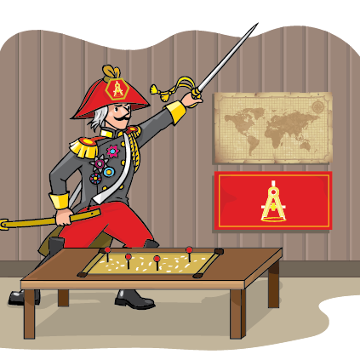
Math Strategy
Entrance Ticket
Learning Targets
Quick Check
Math Strategy
ACT® Practice
Exit Ticket

Slide 2

31.1 Entrance Ticket
1. The expression $\frac{4 + \frac{5}{6}}{2 + \frac{2}{12}}$ is equal to:
A. $\frac{13}{29}$
B. 1$\frac{3}{26}$
C. 2$\frac{3}{13}$
D. 4$\frac{1}{2}$
E. 7
Entrance Ticket
Learning Targets
Quick Check
Math Strategy
ACT Practice
Exit Ticket

Slide 3
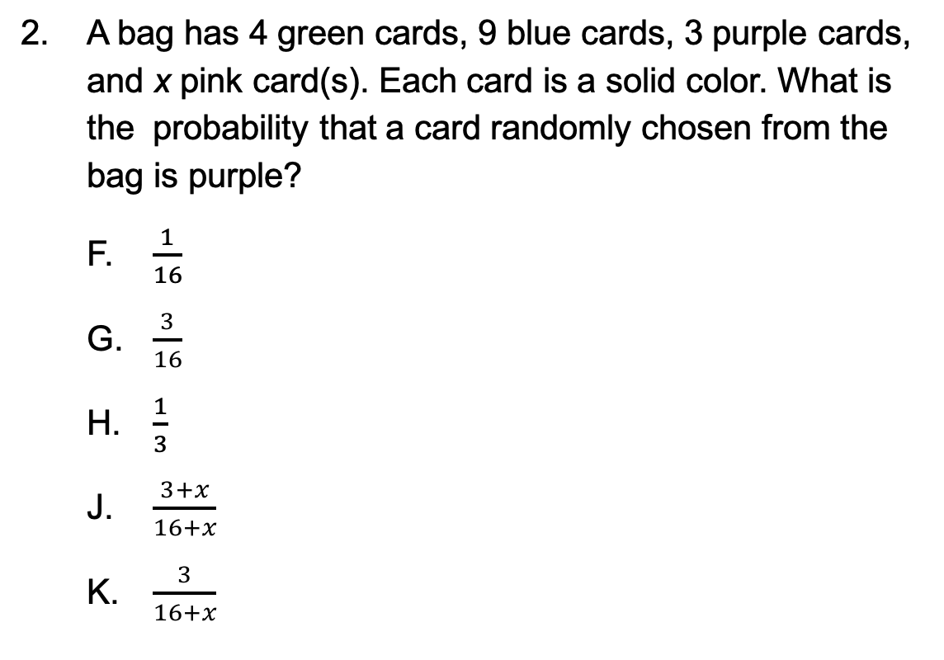
31.1 Entrance Ticket
2. A bag has 4 green cards, 9 blue cards, 3 purple cards, and x pink card(s). Each card is a solid color. What is the probability that a card randomly chosen from the bag is purple?
F. $\frac{1}{16}$
G. $\frac{3}{16}$
H. $\frac{1}{3}$
J. $\frac{3+x}{16+x}$
K. $\frac{3}{16+x}$
Entrance Ticket
Learning Targets
Quick Check
Math Strategy
ACT Practice
Exit Ticket

Slide 4
31.1 Entrance Ticket
3. The local community decides to install a pool beside the park. The pool area will be a rectangular region of 100 yards by 150 yards with an area of 15,000 square yards. The pool itself will take up an area of 25 yards by 50 yards with an area of 1,250 square yards. The community will put up a fence so that only paying members can enter. What is the perimeter of the pool area, in yards, that the fence will cover?
A. 150
B. 250
C. 450
D. 500
E. 650
Entrance Ticket
Learning Targets
Quick Check
Math Strategy
ACT Practice
Exit Ticket

Slide 5
31.2 Learning Targets
Recognize when to use appropriate strategies to answer standard ACT questions
Develop a method to address difficult questions during the test
Self-Assessment
Circle the number that corresponds to your confidence level in your knowledge of this subject before beginning the lesson. A score of 1 means you are completely lost, and a score of 4 means you have mastered the skills. After you finish the lesson, return to the bottom of this page and circle your new confidence level to show your improvement.
Entrance Ticket
Learning Targets
Quick Check
Math Strategy
ACT Practice
Exit Ticket

Slide 6
31.3.1 Show Your Work
It is easy to make a mistake on an ACT problem. Each problem takes multiple steps, and many incorrect answer choices are designed to match your errors.
Entrance Ticket
Learning Targets
Quick Check
Math Strategy
ACT Practice
Exit Ticket

Slide 7
31.3.1 Show Your Work
1. The ratio of x to y is 5 to 7, and the ratio of z to y is 6 to 14. What is the ratio of x to z ?
A. 5 to 3
B. 5 to 6
C. 5 to 12
D. 10 to 7
E. 10 to 13
Entrance Ticket
Learning Targets
Quick Check
Math Strategy
ACT Practice
Exit Ticket

Slide 8

31.3.1 Show Your Work
If f(x) = x³ + 5x and g(x) = $\sqrt[3]{x}$, then what is the value of $\frac{f(4)}{g(8)}$ ?
F. $\frac{1}{21}$
G. 24
H. 42
J. 64
K. 84
Entrance Ticket
Learning Targets
Quick Check
Math Strategy
ACT Practice
Exit Ticket
Entrance Ticket

Slide 9

31.3.1 Show Your Work
3. The expression $\frac{7 + \frac{1}{2}}{3 + \frac{3}{8}}$ is equal to:
A. 2
B. 2$\frac{2}{9}$
C. 3
D. 7$\frac{7}{8}$
E. 10$\frac{7}{8}$
Entrance Ticket
Learning Targets
Quick Check
Math Strategy
ACT Practice
Exit Ticket

Slide 10

31.3.1 Show Your Work
4. What is $\frac{1}{5}$of 37% of $4,300 ?
  F. $18.20
  G. $31.82
  H. $182.00
  J. $318.20
  K. $1,820.00
Entrance Ticket
Learning Targets
Quick Check
Math Strategy
ACT Practice
Exit Ticket

Slide 11
31.3.2 Process of Elimination
The most useful strategy you can use on a multiple-choice test is to eliminate any wrong answers you can identify, even if you don’t know how to find the correct one. Look for any choice that might seem too small, too large, or otherwise contradictory to the information in the question. Eliminate those choices first.
Entrance Ticket
Learning Targets
Quick Check
Math Strategy
ACT Practice
Exit Ticket

Slide 12
31.3.2 Process of Elimination
1. 7x³ · 2x⁸ is equivalent to:
A. 9x⁵
B. 9x¹¹
C. 14x¹¹
D. 9x²⁴
E. 14x²⁴
Entrance Ticket
Learning Targets
Quick Check
Math Strategy
ACT Practice
Exit Ticket

Slide 13
31.3.2 Process of Elimination
2. A certain perfect square has exactly 3 digits (that is, it is an integer between 100 and 999). The positive square root of the perfect square must have how many digits?
F. 1
G. 2
H. 3
J. 4
K. Cannot be determined from the given information
Entrance Ticket
Learning Targets
Quick Check
Math Strategy
ACT Practice
Exit Ticket

Slide 14

31.3.2 Process of Elimination
3. Which of the following inequalities represents the graph shown below on the real number line?
A. $−3≤x≤1$
B. $−3<x≤1$
C. $−3≤x<1$
D. $1<x≤−3$
E. $1≤x<−3$
−3
−2
−1
0
1
2
x
Entrance Ticket
Learning Targets
Quick Check
Math Strategy
ACT Practice
Exit Ticket

Slide 15
31.3.2 Process of Elimination
4. Carl bought a dress for his girlfriend. The dress cost $83.00, and the tax on the dress was 7%. How much did Carl spend on the dress with tax?
F. $83.07
G. $83.58
H. $88.81
J. $89.39
K. $141.10
Entrance Ticket
Learning Targets
Quick Check
Math Strategy
ACT Practice
Exit Ticket

Slide 16
31.3.3 Plug In
Quite a few questions can be solved by plugging in test values or even the answer choices. This strategy is best reserved for when you get stuck, but it can sometimes be the fastest and easiest way to solve a complicated question.
Entrance Ticket
Learning Targets
Quick Check
Math Strategy
ACT Practice
Exit Ticket

Slide 17

31.3.3 Plug In
1. If x is an odd integer, which of the following expressions must be an even integer?
A. 9 + x
B. x⁹
C. 9^{x}
D. $\frac{x}{9}$
E. 9x
Entrance Ticket
Learning Targets
Quick Check
Math Strategy
ACT Practice
Exit Ticket

Slide 18
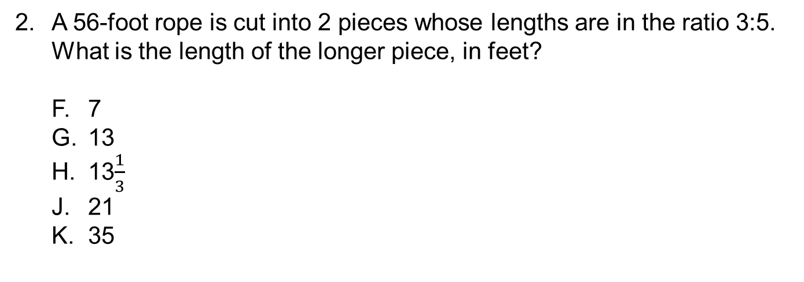
31.3.3 Plug In
2. A 56-foot rope is cut into 2 pieces whose lengths are in the ratio 3:5. What is the length of the longer piece, in feet?
F. 7
G. 13
H. 13$\frac{1}{3}$
J. 21
K. 35
Entrance Ticket
Learning Targets
Quick Check
Math Strategy
ACT Practice
Exit Ticket

Slide 19
31.3.3 Plug In
3. Jeffrey has been putting money in his savings account for the past 4 weeks, with weekly deposits of $135, $236, $583, and $318. How much money must Jeffrey deposit next week in order to maintain this exact deposit average for these weeks?
A. $236
B. $254
C. $272
D. $318
E. $583
Entrance Ticket
Learning Targets
Quick Check
Math Strategy
ACT Practice
Exit Ticket

Slide 20
31.3.3 Plug In
4. John, Carl, and Toby are all employees of a laundromat. John earns three times as much as Carl, and Carl earns $4,000 more than Toby. If x represents the amount that Toby earns, which of the following expressions represents the total amount earned by all 3 employees, in dollars?
F. 5x + 16,000
G. 5x + 12,000
H. 4x + 16,000
J. 4x + 12,000
K. 3x + 16,000
Entrance Ticket
Learning Targets
Quick Check
Math Strategy
ACT Practice
Exit Ticket

Slide 21
31.3.4 Draw It Out
There are many questions on the ACT that don’t give you the whole picture. It could be a geometry question that is missing a figure or a word problem with many moving parts. Fortunately, you have space in your booklet, so you can draw it out.
Entrance Ticket
Learning Targets
Quick Check
Math Strategy
ACT Practice
Exit Ticket

Slide 22
31.3.4 Draw It Out
1. William is stacking boxes on top of each other in a step shape. William plans on stacking 15 rows high, with each row containing 1 fewer box than the row below it. The bottom row consists of 30 boxes. Part of the first 4 rows is shown below. How many boxes will be on the 14th row?
A. 14
B. 15
C. 16
D. 17
E. 18
Entrance Ticket
Learning Targets
Quick Check
Math Strategy
ACT Practice
Exit Ticket

Slide 23
31.3.4 Draw It Out
2. An 8-inch-by-14-inch rectangle is cut along its diagonal to form 2 triangles. What is the area of each of the triangles, in square inches?
F. 11
G. 16.12
H. 22
J. 56
K. 112
Entrance Ticket
Learning Targets
Quick Check
Math Strategy
ACT Practice
Exit Ticket

Slide 24
31.3.4 Draw It Out
3. In a local town election, every member of the town voted. The results were as follows: 25% for Carly, 35% for Jeb, 14% for Carlos, 16% for Kim, and x for other candidates. If the results were to be graphed on a circle graph, what would be the degree measure of the other section?
A. 72
B. 36
C. 20
D. 18
E. 10
Entrance Ticket
Learning Targets
Quick Check
Math Strategy
ACT Practice
Exit Ticket

Slide 25
31.3.4 Draw It Out
4. On the standard (x,y) coordinate plane, what is the midpoint of the line segment with endpoints (2,11) and (–4,5) ?
F. (–2,16)
G. (–1,7)
H. (–1,8)
J. (0,7)
K. (2,9)
Entrance Ticket
Learning Targets
Quick Check
Math Strategy
ACT Practice
Exit Ticket

Slide 26
31.3.5 Objects in the Mirror Are Exactly as They Appear
One of the most helpful things about ACT geometry questions is that the images are almost perfectly drawn to scale, even if the question says they are not. If you get stuck on a really complex geometry question, try to eliminate a few answers just by looking at the figures.
Entrance Ticket
Learning Targets
Quick Check
Math Strategy
ACT Practice
Exit Ticket

Slide 27
31.3.5 Objects in the Mirror Are Exactly as They Appear
1. In the figure below, the measures of 4 angles of pentagon DEFGH are given. What is the measure of angle E ?
A. 94°
B. 96°
C. 105°
D. 119°
E. 129°
D
E
94°
?
96°
173°
H
58°
G
F
Entrance Ticket
Learning Targets
Quick Check
Math Strategy
ACT Practice
Exit Ticket

Slide 28

31.3.5 Objects in the Mirror Are Exactly as They Appear
2. The figure below shows a side view of a cylindrical tank partially filled with water. The tank has a radius of 5 meters. The tank is filled with water to a point where the maximum depth of the water in the tank is 3 meters. What is the length of the chord created by the surface of the water?
F. $\sqrt{21}$
G. 2$\sqrt{21}$
H. 10
J. 15
K. 4$\sqrt{21}$
5
3
Entrance Ticket
Learning Targets
Quick Check
Math Strategy
ACT Practice
Exit Ticket

Slide 29
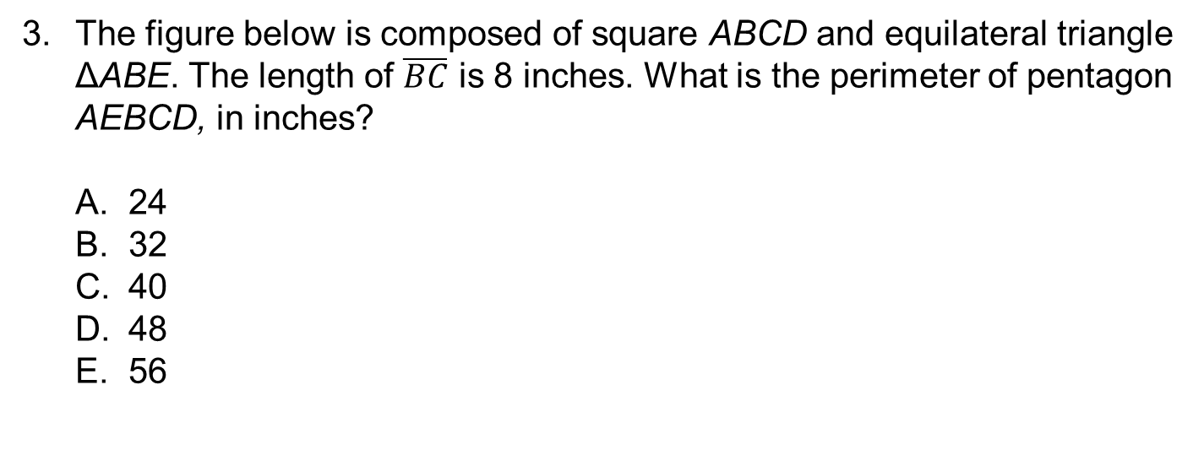
31.3.5 Objects in the Mirror Are Exactly as They Appear
3. The figure below is composed of square ABCD and equilateral triangle ΔABE. The length of $\overline{BC}$ is 8 inches. What is the perimeter of pentagon AEBCD, in inches?
A. 24
B. 32
C. 40
D. 48
E. 56
E
A
B
8
D
C
Entrance Ticket
Learning Targets
Quick Check
Math Strategy
ACT Practice
Exit Ticket

Slide 30
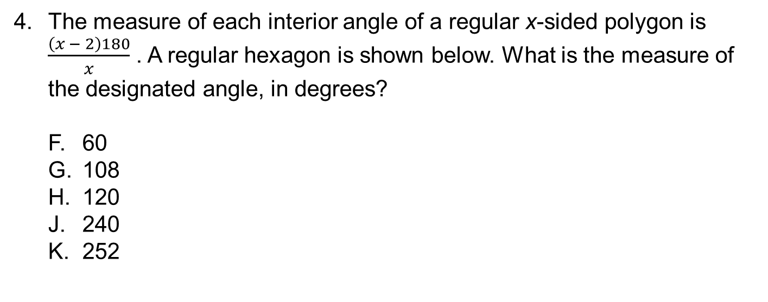
31.3.5 Objects in the Mirror Are Exactly as They Appear
4. The measure of each interior angle of a regular x-sided polygon is $\frac{\left(x − 2\right)180}{x}$ . A regular hexagon is shown below. What is the measure of the designated angle, in degrees?
F. 60
G. 108
H. 120
J. 240
K. 252
?
Entrance Ticket
Learning Targets
Quick Check
Math Strategy
ACT Practice
Exit Ticket

Slide 31
Entrance Ticket
Learning Targets
Quick Check
Math Strategy
ACT Practice
Exit Ticket

Slide 32
31.5 Exit Ticket
Solve the questions on your exit ticket.
Entrance Ticket
Learning Targets
Quick Check
Math Strategy
ACT Practice
Exit Ticket

Slide 33

31.5 Exit Ticket Review
1. A rabbit moves n times as fast as a squirrel. A fox moves m times as fast as a rabbit. The fox moves how many times as fast as the squirrel?
A. m^{n}
B. n^{m}
C. mn
D. n + m
E. $\frac{m}{n}$
Entrance Ticket
Learning Targets
Quick Check
Math Strategy
ACT Practice
Exit Ticket

Slide 34

31.5 Exit Ticket Review
Which of the following is equivalent to $\frac{\frac{2}{5} + \frac{1}{4}}{\frac{3}{4} − \frac{1}{5}}$ ?
F. – $\frac{13}{11}$
G. – $\frac{11}{13}$
H. $\frac{2}{3}$
J. $\frac{11}{13}$
K. $\frac{13}{11}$
Entrance Ticket
Learning Targets
Quick Check
Math Strategy
ACT Practice
Exit Ticket

Slide 35
31.5 Exit Ticket Review
3. A line contains the points k, l, m, and n. Point k is between points m and n. Point l is between points m and k. Which of the following inequalities must be true about the lengths of these segments?
A. ln < mk
B. lk < kn
C. lk < ml
D. mn < mk
E. mk < mn
Entrance Ticket
Learning Targets
Quick Check
Math Strategy
ACT Practice
Exit Ticket

Slide 36
This publication, its author, and its publisher are in no way affiliated with or authorized by ACT, Inc. ACT® is a copyright and/or trademark of ACT, Inc.
Learning Targets

